Slide 1
AI AGENTS

Slide 2
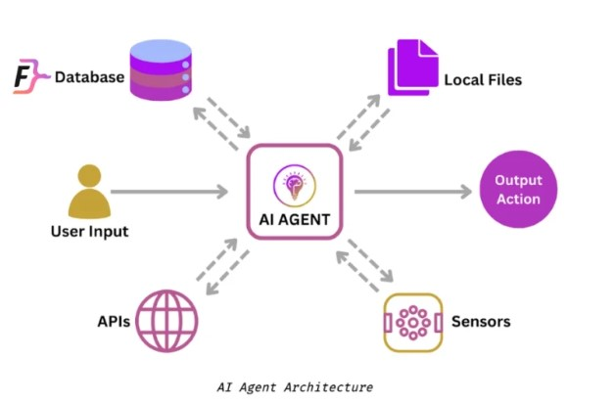
Agents
AI Agents are AI systems that can autonomously execute tasks by making decisions about tool usage and process flow. Unlike traditional automation that follows predefined paths, agents can dynamically adapt their approach based on context and intermediate results. Agents can collaborate to achieve the goal.
AI agent are capable of executing a given task without ongoing direct human intervention. When assigned an objective, an AI agent will perceive its environment, assess the tools at its disposal, and formulate a plan to achieve its given goal.
Agents are also distinct from co-pilots (e.g. traditional chat applications) in that they can fully automate a task, as opposed to simply augmenting and extending human input.
Agents → non-linear, non-deterministic (can change from run to run)
Workflows → linear, deterministic execution paths
Co-pilots → augmentative AI assistance requiring human intervention

Slide 3
Example: booking vacations(p1)
Lets illustrate how an agent works within a context like booking a vacation.
Imagine you're trying to book a vacation. You need to research flights, find hotels, check restaurant reviews, and keep track of your budget.
Traditional workflow automation
A traditional automation system follows a predetermined sequence: it can take inputs such as dates, location, and budget, and make calls to predefined APIs in a fixed order. However, if any unexpected situations arise, such as flights being sold out, or the specified hotels being unavailable, it cannot adapt.
Input
step1
step2
step3
Output

Slide 4
Example: booking vacations(p2)
AI co-pilot
A co-pilot acts as an intelligent assistant that can provide hotel and itinerary recommendations based on your preferences. If you have questions, it can understand and respond to natural language queries and offer guidance and suggestions. However, it is unable to take the next steps to execute the end-to-end action on its own.
Input
LLM
Human Input
Action

Slide 5
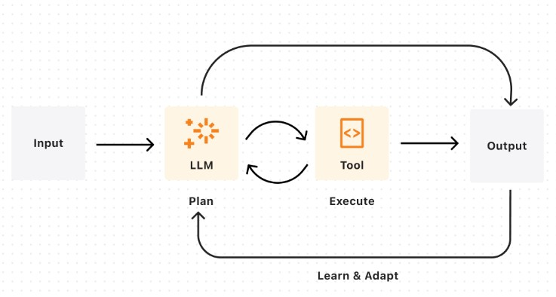
Example: booking vacations(p3)
Agent
An agent combines AI's ability to make judgements and call the relevant tools to execute the task. An agent's output will be nondeterministic given: real-time availability and pricing changes, dynamic prioritization of constraints, ability to recover from failures, and adaptive decision-making based on intermediate results. In other words, if flights or hotels are unavailable, an agent can reassess and suggest a new itinerary with altered dates or locations, and continue executing your travel booking.

Slide 6
Some examples of AI Agent(p1)
simple tasks:
agent that could help me review my emails and create tasks on a digital to-do list based on the highest priority emails coming in.
agent that uses weather data and other information to decide when to water my garden and how long to water it for.
an agent that could respond to people reporting bugs and automatically gather missing information and seek clarification on confusing parts of a bug report and then route the bug to the appropriate team to resolve.
agent could use a camera to look at a Rubik's cube and then use robotic manipulators to solve it.

Slide 7
Some examples of AI Agent(p1)
Complicated tasks:
agent also to build a travel planning agent that takes my preferences and needs into account, researches things like destinations and hotels and even activities, and then suggests an itinerary for me and use a collaborating agent to book everything all in one shot.
agent to find a list of suppliers, email them for quotes, and sort replies according to the best price.
agent to create a shopping list based on a recipe, purchase the ingredients online, and have them delivered to you.
agents that monitor patients vitals, and suggest treatment plans and even support surgical procedures by providing realtime data to surgeons

Slide 8
How Does an AI Agent Work?(p1)
In essence, an AI agent works through the process of assigning, creating, or inferring an objective, which it will then break down into a series of tasks and attempt to complete. This process can be divided into three stages:
Task definition and planning,
Decision-making, and
Feedback and adaptation.
1. Task Definition and Planning
Define and assign an objective: giving an agent a predefined goal you want it to accomplish.
Assign Resources: select the tools and sources of information the agent will be permitted to use to achieve its goal.
Environmental assessment: the agent uses sensors and any other available data sources to collect information about its environment; this helps it understand its given task in greater context, as well as potential obstacles.
Plan generation: taking the tools at its disposal into account, the agent devises strategies for achieving its goal, which typically involves breaking down its tasks into subtasks, and potentially also breaking the goal down into subgoals.

Slide 9
How Does an AI Agent Work?(p2)
2. Decision-Making
Data analysis: analyzing available data – such as environmental sensor readings, past experiences, and the model that powers it, to predict the outcomes of prospective actions it could take.
Action execution: the agent sequentially selects and executes the action it has determined will maximize the likelihood of success.
3. Feedback and Adaptation
Performance Monitoring: the agent monitors the outcome of its actions and evaluates if they brought it closer to accomplishing the given objective.
Feedback loop: The agent uses the feedback to adjust its strategy and potential actions to take. If permitted, i.e., if programmed to do so, it can ask for human intervention if it is stuck on a task.
Adaptation and learning: The agent continuously learns from its experiences. It monitors the results of its actions and updates its knowledge base and decision-making processes based on the new information.

Slide 10
The Components of an AI agent
AI Model: recent advances such as an LLM, VLM (vision-language model), or, more recently, LMM (large multi-modal model) could be used as the core of an AI agent, acting as its decision-making mechanism. The model will process data collected by sensors, make decisions based on said data, and take actions to achieve the agent’s goals.
Sensors: components responsible for collecting data from the agent’s environment so it can “perceive” it accurately and act accordingly. Sensors are an agent’s input devices, enabling it to learn about the world. In software agents, a sensor would be digital interfaces to websites or databases, while in a robotic agent, these include cameras and microphones.
Actuators: these are an agent’s means of output – enabling it to take actions based on its given objective and data collected from its sensors. In software agents, these are components that can control other applications or devices, while for a robotic agent, these could be appendages, i.e., limbs, display screens, or speakers.

Slide 11
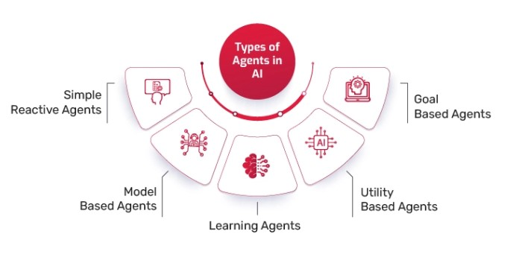
Types of AI Agents(p1)
Reactive Agents
These agents do not have memory or the ability to learn from past experiences.
They respond directly to environmental stimuli based on predefined rules.
Example: Chess-playing AI (Deep Blue) – It makes moves based only on the current board state.
Model-Based (Deliberative) Agents
These agents maintain an internal model of the world and use it to make decisions.
They can plan actions based on their understanding of the environment.
Example: Self-driving cars – They build a model of the surroundings to navigate safely.

Slide 12
Types of AI Agents(p2)
Goal-Based Agents
They take actions that bring them closer to achieving a specific goal.
They evaluate different possible actions and select the one that maximizes goal achievement.
Example: Pathfinding AI in robotics and games – It determines the shortest route to a destination.
Utility-Based Agents
They optimize actions based on a utility function, considering multiple factors like cost, efficiency, and risk.
Used in applications requiring decision-making under uncertainty.
Example: Recommendation systems (Netflix, Spotify) – They optimize user engagement and satisfaction.

Slide 13
Types of AI Agents(p3)
Learning Agents
These agents improve their performance by learning from past experiences.
They use machine learning techniques to adapt to new data and environments.
Example: Chatbots (ChatGPT, Bard) – They learn from user interactions to improve responses.
Multi-Agent Systems (MAS)
A group of AI agents that work together to achieve a common goal.
Used in swarm robotics, distributed computing, and collaborative AI.
Example: Stock trading AI – Multiple AI agents analyze different market aspects and make trading decisions collectively.

Slide 14
Types of AI Agents(p4)
Theory of Mind Agents
The theory of mind defines each living being as having sentiments, thoughts, ideas, and a mental state distinct from the others. A theory of mind AI agent describes the next step in artificial intelligence evolution. It is a leap forward from the Reactive and Limited Memory systems and describes agents as having a deeper understanding of the human mind. These agents understand complex emotional states and consider them when making a decision.

Slide 15
Types of AI Agents(p5)
Self-Aware Agents
Self-awareness is an extension of the theory of mind principle. A self-aware agent not only understands others but also itself. It has a working consciousness and sense of being similar to humans. Theoretically, a self-aware agent will be a sentient being that thinks and behaves exactly like a human, and its interactions will reflect emotional prowess.
The theory of mind and self-awareness stages are the true representation of a sentient AI. However, these developments are still a topic of research, and little advancement has been made toward reaching human-level cognition. Current AI systems lack the depth of understanding, reasoning, and subjective experience that characterize true sentience.
Significant progress has been made in areas like natural language processing (NLP) and emotional simulation. However, the leap to a fully self-aware or conscious AI, capable of independent thought and genuine emotions, remains speculative and far from realization.

Slide 16
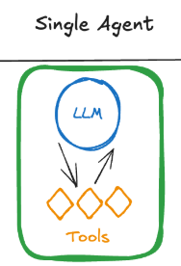
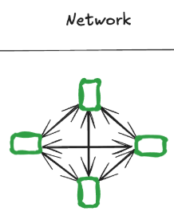
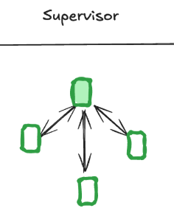
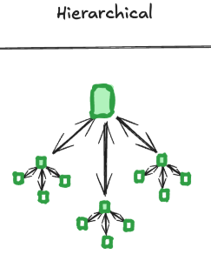
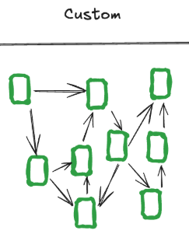
Multi-Agent Systems(p1)
A multi-agent system (MAS) is a framework that allows multiple AI agents to collaborate to solve problems and achieve predetermined goals.
They offer several benefits over systems consisting of a single AI agent:
- If a single agent has too many tools at its disposal, then MAS makes decision which tools to invoke. You have more control on how task are to be executed
MAS are capable of taking on more complex tasks: A key reason for this is that agents in MAS can learn from the behavior of other agents as well as their environment.
MAS are modular and hence scalable – additional agents can be instantiated if the existing system isn’t up to the task, or can’t cope with growing demand.

Slide 17
Multi-Agent Systems(p1)
- MAS are more fault-tolerant to individual agent failures than single-agent systems. This offers higher availability, which is desirable if the agent-powered system represents a critical function.
MAS can achieve its given goal is to have agents cooperate to reach a desired objective. This could involve agents sharing information about the measures they have taken so far, so other agents avoid wasting effort.
You can create multiple specialized agents that are expert in their domain
Types of MAS: Network, Supervisor, Hierarchical, Custom (Explained later)

Slide 18
Multi-Agent Systems Architecture(p2)
Lets understand single agent first and its limitations:
Single Agent:
Relies on one LLM or tool to perform all tasks sequentially.
SA work well for simple workflows.
3 Challenges of Single-Agent Systems:
A) Tool Overload:
1. Handling numerous tools can confuse decision-making.
2. Incorrect decisions in tool selection can cascade, causing failures in subsequent steps.
3. Constant back-and-forth among tools slows down the system.
Empirical observations suggest that a sweet spot exists for tool usage: 5-10 tools.
Below this range the agent may lack capabilities to perform complex workflows.
Above this range the agent’s ability to choose tools effectively diminishes.
LLM
Tool1
Tool2
Tool3

Slide 19
Multi-Agent Systems Architecture(p3)
B) Contextual Limitations: In SA system, LLMs struggle to maintain effective performance when overloaded with growing context. LLM have a finite context window, which determines how much information they can process at once.
As interactions expand in complexity following issues arises:
Contextual Overload: The agent’s memory is overwhelmed by the growing number of tasks, tool outputs, and user interactions.
Performance Drops: The LLM may lose important details, leading to incomplete or incorrect responses.
Inefficiencies: Repeated reinitialization of context for different tasks increases latency and computational costs.
Example: Imagine an agent interacting with a user and calling tools to:
1. Retrieve data.
2. Analyze it.
3. Generate a report.
By the time it reaches step 3, the LLM may have lost critical details from step 1 due to context overflow, resulting in flawed outputs.
LLM
Retrieve Data
Analyze data
Generate Report

Slide 20
Multi-Agent Systems Architecture(p4)
C) Specialization Deficiency: A single agent cannot excel in diverse tasks requiring varied expertise. If a single agent is expected to handle diverse tasks — ranging from planning and research to coding and mathematical analysis, then this expectation creates challenges:
1. Skill Dilution: A single LLM lacks the depth to perform each task with high expertise.
2. Task Complexity: As tasks become more domain-specific, they require specialized knowledge that a generalized single agent cannot provide.
3. Performance Inefficiencies: Switching between different types of tasks introduces friction, reducing overall system responsiveness.
Example: A user needs an AI assistant to:
- Plan a project timeline.
- Write a Python script for automation.
- Generate a financial forecast.
A single agent may struggle to excel in all three areas simultaneously, leading to suboptimal results.
LLM
Plan Project Timeline
Write Python script
Generate Fin. Forecast

Slide 21
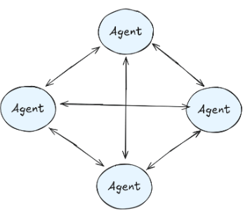
Multi-Agent Systems Architecture(p5)
4 types of MAS:
Network MAS: multiple agents operate independently, each equipped with their own tools, and communicate by routing tasks among themselves. This architecture leverages collaboration and coordination between agents for solving complex problems.
Framework like Swarm, CrewAI, LangGraph use this architecture.
SA's communicate by determining the next agent in the sequence to handle a task. Routing decisions are made dynamically, based on the current task and agent capabilities.
Advantage of network MAS
Decentralized Decision-Making: Agents can make independent decisions, reducing reliance on a single central controller.
Flexibility: The architecture can adapt dynamically to changing task requirements or agent capabilities.
Parallelism: Multiple agents can operate concurrently, improving system throughput for tasks that can be processed in parallel.

Slide 22
Multi-Agent Systems Architecture(p6)
Disadvantages of Network MAS
Loose Communication Patterns: Lack of strict control over how agents communicate leads to unpredictability. Agents may route tasks inefficiently, causing delays or redundant work.
High Costs: Frequent communication between agents results in excessive LLM calls, increasing operational costs. Agents may unnecessarily route tasks back and forth, compounding expenses.
Unreliability in Production: The decentralized nature makes debugging and error handling challenging. Inconsistent task routing can lead to failed workflows or incomplete results.
Coordination Overhead: With no central control, maintaining coordination across agents requires complex protocols, adding computational overhead.
Practical Applications of N/w MAS
While the network of agents architecture is rarely recommended for production due to its inefficiencies, it has niche applications in:
- Exploratory Systems: Research prototypes or academic experiments where flexibility and dynamic task routing are prioritized over cost and reliability.
- Distributed Problem Solving: Use cases like swarm intelligence, where decentralized agents simulate behaviors found in natural systems (e.g., ant colonies, bird flocks).

Slide 23
Multi-Agent Systems Architecture(p7)
2. Supervisor Agent
How It Works
Supervisor Agent:
- Acts as the central controller.
- Decides which sub-agent should handle a specific task based on the task requirements.
- Manages the overall workflow and ensures the completion of tasks in a structured manner.
Sub-Agents:
- Specialized agents with expertise in specific domains (e.g., data analysis, coding, content generation).
- Perform their tasks independently without worrying about routing or decision-making.
Communication Flow:
- The supervisor receives a task, analyzes it, and routes it to the appropriate sub-agent.
- The sub-agent processes the task and returns results to the supervisor, which then decides the next steps.

Slide 24
Multi-Agent Systems Architecture(p8)
Advantages of Supervisor MAS
a) Simplified Sub-Agent Roles: Sub-agents focus exclusively on their tasks, without needing to handle routing or inter-agent communication. This improves their efficiency and accuracy.
b) Centralized Control:
The supervisor ensures that tasks are executed in the correct sequence, reducing errors caused by miscommunication.
It provides a clear view of the overall workflow, making it easier to debug and maintain.
c) Scalability:
New sub-agents can be added to the system without disrupting the existing architecture.
The supervisor can dynamically allocate tasks to the most suitable agent.
d) Improved Resource Management: The supervisor optimizes task routing to minimize redundant LLM calls and computational overhead.

Slide 25
Multi-Agent Systems Architecture(p9)
Challenges of supervisor MAS
Supervisor Bottleneck:
If the supervisor becomes overloaded with too many tasks or too much decision-making, it can slow down the entire system.
Mitigation: Using a hierarchical approach where supervisors manage groups of sub-agents.
Complex Supervisor Logic:
Designing the supervisor’s task-routing logic can become complex, especially in dynamic environments with many sub-agents.
Single Point of Failure:
The system’s functionality heavily depends on the supervisor. If it fails, the entire workflow is disrupted.
Mitigation: Implementing redundancy or fallback mechanisms.

Slide 26
Multi-Agent Systems Architecture(p10)
Example Use Case of supervisor MAS
A company develops an AI-powered business assistant:
1. The supervisor agent handles user requests and delegates them to sub-agents. Example: A user asks for a project timeline and budget analysis.
2. Sub-agent 1 (Planner) creates the project timeline.
3. Sub-agent 2 (Finance Expert) performs budget analysis.
4. Results are returned to the supervisor, which consolidates and delivers the final output to the user.

Slide 27
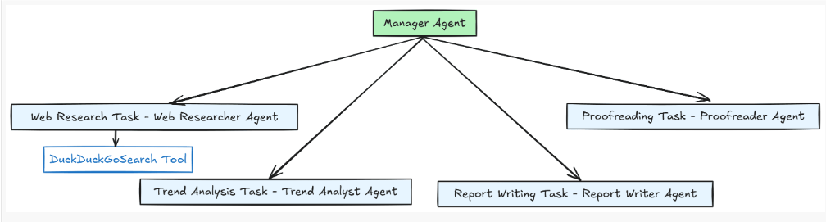
Multi-Agent Systems Architecture(p11)
Example Use Case of supervisor MAS: MAS to generate a report on a specific topic we want
The structure detail is simple; we will have four specialized agents:
Web researcher agent
Trend analyst agent
Report writer agent
Proofreader agent
The manager agent supervises all of these agents which only perform their tasks if directed. Additionally, the web researcher agent has access to the web search tool to access the internet to research the intended topic.

Slide 28
Multi-Agent Systems Architecture(p12)
3. Hierarchical MAS
How It Works
Layered Supervision:
A top-level supervisor agent manages high-level tasks and delegates them to mid-level supervisor agents. These mid-level supervisors handle specific groups of sub-agents, each specializing in distinct domains or tasks.
Sub-Agents:
Operate at the lowest level, performing specific tasks based on instructions from their respective supervisors. Sub-agents focus solely on execution, leaving routing and decision-making to their assigned supervisors.
Task Flow:
- Tasks are broken down at each hierarchical level. The top-level supervisor divides a large task into manageable subtasks. Mid-level supervisors further refine and distribute these subtasks to sub-agents.
Communication:
- Supervisors communicate with their direct subordinates (other supervisors or sub-agents).
- Results flow upward through the hierarchy for aggregation and final output.

Slide 29
Multi-Agent Systems Architecture(p13)
Advantages Hierarchical MAS
Scalability:
The hierarchical structure supports systems with a large number of sub-agents by distributing the workload across multiple layers.
Each supervisor only needs to manage a subset of the overall tasks, reducing bottlenecks.
Specialization:
Mid-level supervisors can manage groups of sub-agents specializing in particular domains (e.g., financial analysis, content generation). This enables highly modular and efficient task execution.
Improved Efficiency: Breaking tasks into smaller subtasks and routing them to appropriate agents minimizes processing delays and resource usage.
Enhanced Debugging and Maintenance:
The layered structure allows pinpointing of errors or bottlenecks to a specific supervisor or sub-agent.
Maintenance is easier since changes in one layer do not necessarily affect others.

Slide 30
Multi-Agent Systems Architecture(p14)
Challenges of Hierarchical MAS
Design Complexity:
Building a multi-layered supervisor system requires careful planning to ensure tasks are routed efficiently.
Designing logic for supervisors at each level can be time-consuming and prone to errors if not well-structured.
Communication Overhead:
Hierarchical communication can introduce latency as information flows through multiple layers.
Mitigation: Optimize task granularity to reduce unnecessary back-and-forth between layers.
Single Point of Failure at the Top:
The top-level supervisor is critical to system functionality. If it fails, the entire hierarchy is disrupted.
Mitigation: Introduce redundancy or a failover mechanism for the top-level supervisor.
Resource Management:
Large systems with many layers can consume significant computational resources.
Mitigation: Monitor and optimize resource allocation, ensuring supervisors at all levels operate efficiently.

Slide 31
Multi-Agent Systems Architecture(p15)
Practical Applications of hier. MAS
Enterprise Automation: Complex workflows requiring task division across multiple departments, such as project planning, resource allocation, and reporting.
Autonomous Systems: Scenarios like autonomous vehicles, where high-level supervisors manage route planning while lower layers handle obstacle avoidance and vehicle control.
Dynamic Multi-Agent Systems: Real-time decision-making systems, such as financial trading bots, where tasks must be delegated and resolved quickly across layers.

Slide 32
Multi-Agent Systems Architecture(p16)
Example Use Case of Hier. MAS: AI-Powered Research Platform
Top-Level Supervisor:
Receives a request to generate a comprehensive research report.
Breaks the task into subtasks: literature review, data analysis, and report writing.
Mid-Level Supervisors:
Literature Supervisor: Manages sub-agents specialized in retrieving and summarizing articles.
Data Supervisor: Delegates tasks to agents performing data collection and statistical analysis.
Content Supervisor: Coordinates agents responsible for drafting and editing the report.
Sub-Agents:
Each sub-agent performs its specific role (e.g., searching academic databases, running statistical tests, or refining written content).
Results Aggregation:
Results flow back up the hierarchy, where the top-level supervisor consolidates them into the final output.

Slide 33
Multi-Agent Systems(p2)
Examples of MAS:
Stock market simulation :A classic example of MAS is a stock market simulation where multiple "agent" programs representing different traders interact with each other, buying and selling stocks based on their own algorithms and strategies, simulating real market dynamics and competition.
Robot soccer team: Multiple robots on a field act as individual agents, coordinating their movements and actions to play against another team, simulating real soccer strategies.
MAS can be used for tasks like coordinating multiple robots to perform complex jobs, such as search and rescue

Slide 34
Benefits of AI Agents
Efficient Automation: AI agents can take on repetitive tasks such as FAQs, common requests, batch jobs, etc., without the need for human involvement. This frees up employees to work on more rewarding and value-adding activities.
Improved Decision-Making: agents can analyze vast amounts of data faster and more accurately than a person can, allowing for better data-driven decision-making.
Reduced Human Error: subsequently, the ability to process large amounts of data with greater accuracy means work carried out by agents does not suffer from the mistakes made by humans.
Increased Availability: AI agents are scalable and deployable around the clock. This ensures that services or support are available any time a user requires it.
Increased Safety: autonomous agents can be deployed in dangerous environments, replacing the need for humans and eliminating the risk of injury or catastrophic loss as a result.
Cost Savings: as a result of the automation offered by agents, the workforce is freed from the burden of mundane work, boosting their productivity and optimizing labor costs.
Scalability: As your user base or data grows, more agents can easily be deployed at scale to meet demands.

Slide 35
Applications of AI Agents(p1)
Virtual Assistants: services like Siri, Alexa, and Cortana are actually AI agents that are capable of understanding natural language commands in real-time and performing a wide variety of tasks like researching the answers to questions, ordering items, and controlling internet-connected smart devices.
Customer Service Chatbots: used by organizations to automate customer service interactions. In addition to answering common questions, agents reroute queries and escalate more involved issues to human personnel.
Recommendation Engines: AI agents can learn user preferences from past behavior to offer personalized recommendations for products, services, or content. Streaming services like Netflix and eCommerce platforms like Amazon are prominent examples of this.
E-Learning Agents: these deliver educational content based on a student’s particular competence and rate of progress. For instance, they will provide additional resources for areas the student finds challenging while skipping over familiar material.

Slide 36
Applications of AI Agents(p2)
Data Analysis and Forecasting: agents can process and interpret vast datasets to identify patterns and anomalies in an effort to predict future events. This is ideally suited for the financial industry that uses such predictive analysis to identify stock market trends, fluctuations, and potential risks – to optimize investment strategies.
Real-time Cybersecurity Monitoring and Alerting: AI agents are capable of monitoring IT infrastructure and spotting potential security breaches around the clock – and with far more accuracy than any single human can.
Diagnosis and Treatment Agents: an agent’s ability to process massive amounts of data and detect patterns is also useful in the medical field. AI agents can help identify medical conditions from a patient’s data – particularly when it comes to analyzing patterns in images as well as in large amounts of suitably anonymized data (across patients).

Slide 37
Applications of AI Agents(p3)
Robotics: self-driving vehicles and autonomous drones are examples of robotic agents that use sensors and actuators to interact with physical environments. Meanwhile, in sectors such as large-scale manufacturing, industrial robots are used as agents to perform work such as assembly and welding.
Infrastructure and System Monitoring: AI agents help in overseeing industrial infrastructure and systems, detecting anomalies in equipment that could signal an impending failure.
Gaming: Non-playing characters (NPCs) in video games are a basic form of agent that simply responds to a user’s actions. However, more advanced agents can add realism to games: a trend that will become more prevalent as we move into Virtual and Augmented Reality environments.

